Slide 1
STAT 430 Final Project -
Crimes in Chicago
Jonathan Kang and Zack Labus
(Group 14)

Slide 2
Introduction
During COVID periods, we have seen an increase in reports for criminal activity in Champaign
Strengthened partnership with Police Department
Has COVID impacted crime rates and can we classify the possible category of criminal activity given circumstances?
Understand if there are patterns in crime activity and the categories in criminal activity
Our Dataset:
Dataset is provided by Chicago Police Department (https://data.cityofchicago.org/Public-Safety/Crimes-2001-to-Present/ijzp-q8t2)
Updated daily since 2001
Some important variables:
Date
Location Description
Community Area
Beats
Primary Type
Crime Description

Slide 3
Related Works
3 Articles with Similar Work:
“Crime Rate Inference with Big Data” - Hongjian Wang et al. (2016)
Uses Linear Regression and Negative Binomial Distribution to build a nodal model to understand geographical locations of various crimes
“Property Crime Specialization in Detroit, Michigan” - Felson et al. (2022)
Performed pairwise comparisons for crime hotspots to understand whether areas in Detroit had a specialized class of crime activity.
“A Proposed Framework for Analyzing Crime Data Set Using Decision Tree and Simple K-Means Mining Algorithm” - Al-Janabi, Kadhim B. Swadi (2011)
Used decision trees and k-means algorithms to find to forecast criminal activity in the future.

Slide 4
Method - Decision Tree
Predict the type of crime being committed given a time, day of the week, description of the location, and the specific community area in Chicago.
Build a decision tree
Variables we are working with are categorical and it was most simple to implement and understand.
To find best decision tree, we utilized pruning techniques, which reduces the size of the tree and removes redundant non-critical sections. Best model was found to have a max depth of 12 layers and a minimum sample leaf of 20.
Finally, we use 2019-2021 crime data as our training data, and 2022 crime data as our testing data. We can test for accuracy by comparing the actual results of 2022 crime data with our decision tree.

Slide 5
Method - Time Series
Make a time-series model that would generate forecasts for the number of criminal activities.
Considering the trend and seasonal components could be important in this model, we used a Holt’s exponential smoothing model.
Similar to the decision tree model, we split the data into training and testing sets.
To determine the best forecast range and model accuracy, we checked the different resulting mean squares errors and the normalized scores.

Slide 6
Methods - Clustering
The third goal we had was to see if we could group community areas into clusters, with those clusters revealing similarities in crime frequencies among Community areas in Chicago.
We used a K-means model and utilized the elbow method to determine the optimal number of clusters.
After grouping the data by community area to get counts for each type of crime in each community area, we normalized the data.
In order to use all variables, we had to reduce dimensionality by applying PCA.

Slide 7
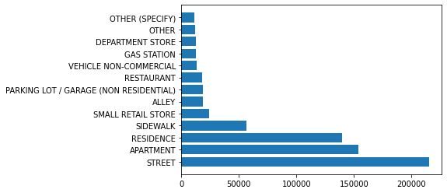
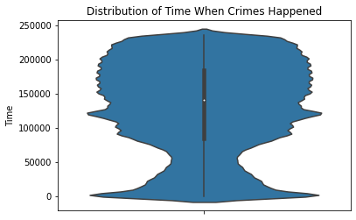
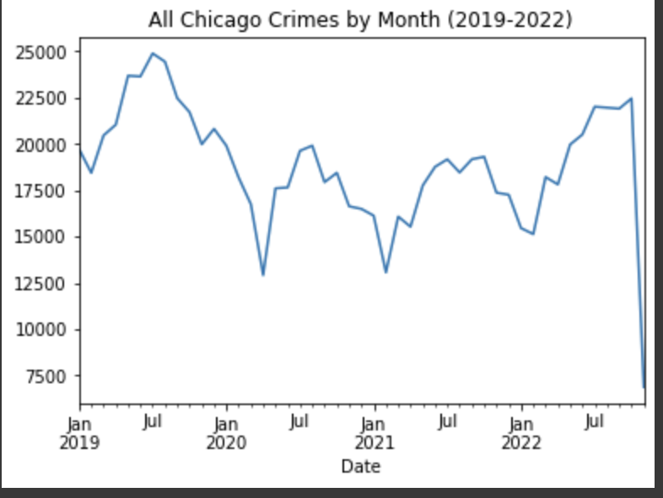
Results - EDA

Slide 8
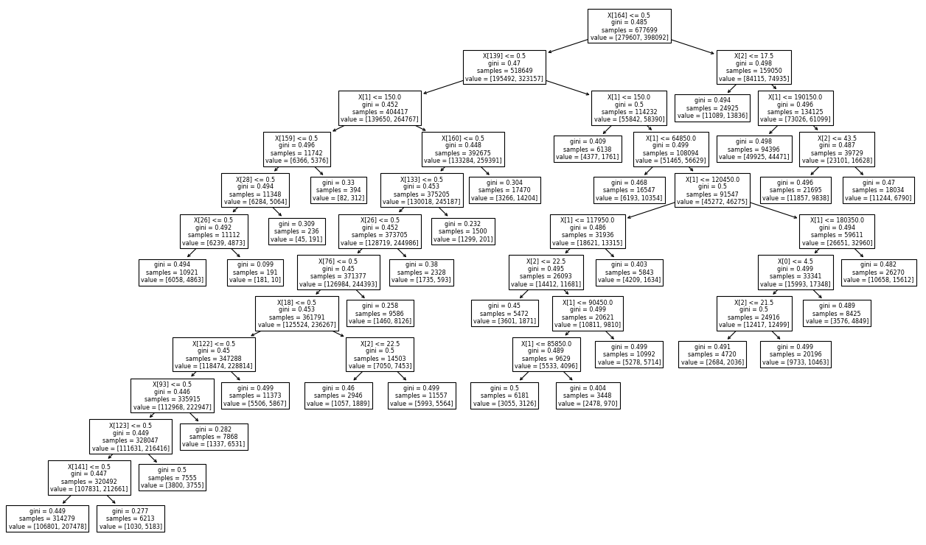
Decision Tree has accuracy of 61.39%
Considered “average” machine-learning result
Results - Decision Tree Model

Slide 9
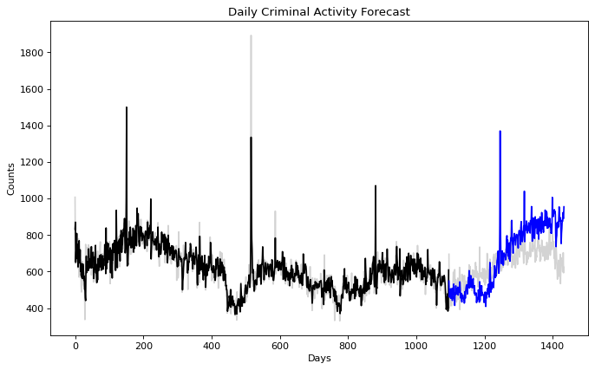
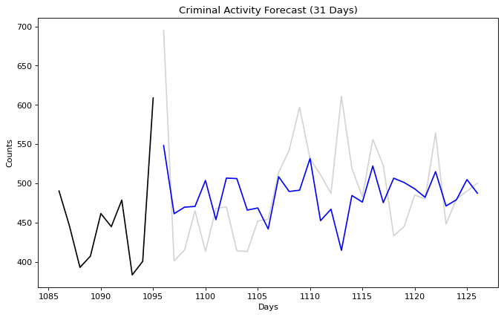
Trend is somewhat similar in the first half, but deviates in the 2nd half.
Found that forecasting for 31 days results in lowest RMSE and NRMSE of 62.905 and .128 respectively.
Results - Time Series Model

Slide 10
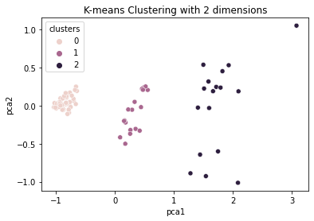
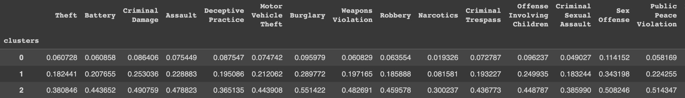
Model shows that in cluster 0, Theft is less common than in clusters 1 and 2. Each community area can look at the cluster they belong to and see which crimes are more and less frequent in their cluster.
Results - K-means Model

Slide 11
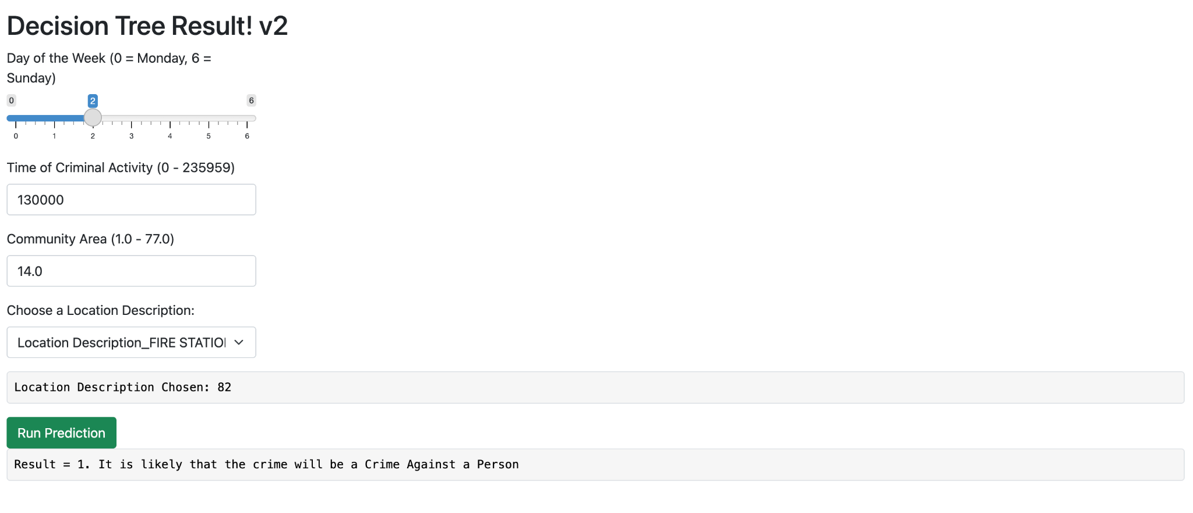
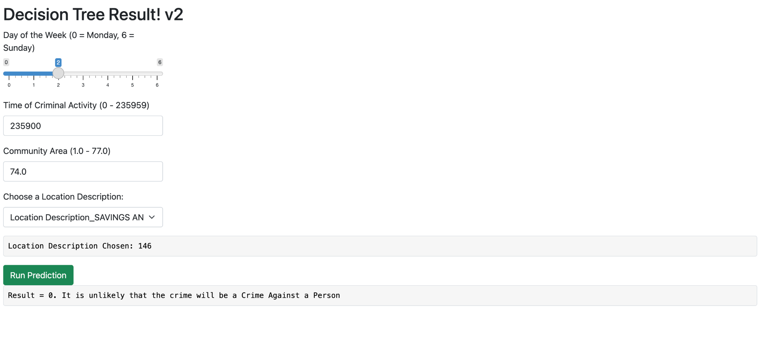
Results - Shiny App

Slide 12
Conclusion
Exploratory Data Analysis
Decreased crime rates throughout COVID
Spike around June 2020
Most crimes happen afternoon to midnight, with most crimes happening during 12 am
Models
Our decision tree accurately predicts 61.39% of crimes against a person or not
There is a clear trend of crimes throughout the year
Our forecast model may not be the most accurate with NRMSE of 12.8%
K-means helps identify similarities and differences in community areas
Limitations
Only explored dataset between 01/01/2019 and 12/11/2022
Lacking in understanding between the definitions of different crime descriptions
K-means model least useful, but with more time could be used more effectively
Improvements
Explore a larger range of data
Utilize other machine learning methods and see if there are hotspots for specific types of crimes
Use Random Forests for classification model to account for randomness

